Slide 1
Drawing Comparisons Between Micorbe VOCs and SWD Behavior
Microbe VOCs collected from:
F. faeni in 10% juice
P. agglormeans in 10% juice
F. faeni and P. agglormeans mixed together in 10% juice (both at same relative initial conc/amount)
SWD Bioassay data needed
F. faeni in 10% juice vs. SWD - repellent
P. agglormeans in 10% juice vs. SWD - attractant
F. faeni vs. P. agglormeans in 10% juice in a single cage vs. SWD – is the choice confirmed
F. faeni & P. agglormeans mixed together in 10% juice vs. SWD – dominate microbe? This brings up next questions as to mechanism (pop, priority, metabolites, host, or other)

Slide 2
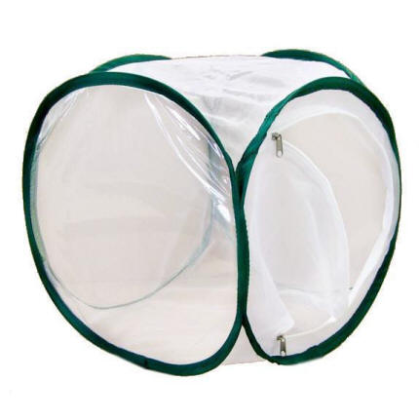
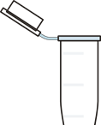
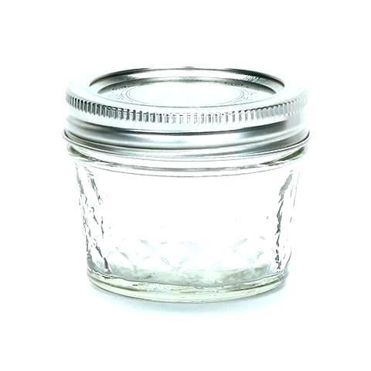
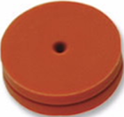
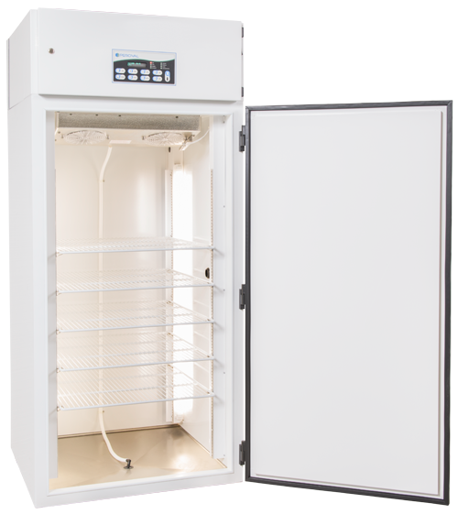
Equipment
Mesh Cages
Trap Jars
4 oz ball jar
Metal lid ring
Teflon lid cover with 2 holes
1 septa covered hole
1 hole plugged with a centrifuge tube
Incubators
25 C, 60% rH, and 16:8 L:D

Slide 3

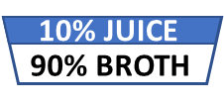
What is in a name?
Blank
Control
Treatment
1 mesh cage
2 empty trap jars
1 mesh cage
2 trap jars
10% juice
90% culture broth
1 mesh cage
2 trap jars
10% juice
90% culture broth
Microbes
10% JUICE
90% BROTH
10% JUICE
90% BROTH

Slide 4
How will the environment effect the flies?
How do the SWD flies respond to an empty trap jar in the closed incubator environment? Flies exposed to 2 blank traps
How do the SWD flies respond to a control solution of blueberry juice and broth (blank, control) in the closed incubator environment? (contamination?) 2 mesh cages – 1 with blank + flies, 1 with control + no flies
Do the SWD flies prefer the control solution over an trap jar in the closed incubator environment? (1 mesh cage, blank v ctrl, and flies)
VS.
10% JUICE
90% BROTH

Slide 5
What happens when we add the microbes?
How do the SWD flies respond to an empty (blank) trap jar in the closed incubator environment with microbes producing VOCs?(silica absorption, 2 mesh)
How do the SWD flies respond to a control solution of blueberry juice and broth in the closed incubator environment with microbes producing VOCs? (same GC, diff cages)
Do the SWD flies prefer the control solution over an trap jar in the closed incubator environment with microbes producing VOCs? (1 mesh, choice)
Do the SWD flies prefer the control solution over a blank jar in the closed incubator environment with microbes producing VOCs? (similar to pg 150)
VS.
VS.
10% JUICE
90% BROTH

Slide 6
SWD Choice Bioassay: Blank vs. Control & Treatment vs. Control
Week 1: Blanks vs Control Samples in Incubator
24H: 2 Mesh cages with 2 blank traps (50 flies)
24H: 1 Mesh cages with 1 blank and 1 control trap (50 flies)
24H: VOC from each trap
This addresses 10% bbjb contaminate blank jar between 1 mesh and cages
Week 2: Treatment vs Control Sample in Incubator
2H: 2 Mesh cages with 1 treatment and 1 control trap (50 flies)
2H: 1 Mesh cages with 1 treatment and 1 blank trap (50 flies)
2H: VOC from each trap
24H: 2 Mesh cages with 1 treatment and 1 control trap (50 flies)
24H: 1 Mesh cages with 1 treatment and 1 blank trap (50 flies)
24H: VOC from each trap
48H: 2 Mesh cages with 1 treatment and 1 control trap (50 flies)
48H: 1 Mesh cages with 1 treatment and 1 blank trap (50 flies)
48H: VOC from each trap

Slide 7
SWD Choice Bioassay: Microbe vs. Control
Week 3: F. faeni vs SWD
2H: 5 Mesh cages with 1 treatment and 1 control trap (50 flies)
2H: 2 Mesh cages with 1 control and 1 blank trap (50 flies)
2H: VOC from each trap
24H: 5 Mesh cages with 1 treatment and 1 control trap (50 flies)
24H: 2 Mesh cages with 1 control and 1 blank trap (50 flies)
24H: VOC from each trap
48H: 5 Mesh cages with 1 treatment and 1 control trap (50 flies)
48H: 2 Mesh cages with 1 control and 1 blank trap (50 flies)
48H: VOC from each trap
Week 4: P. agglormeans vs SWD
2H: 5 Mesh cages with 1 treatment and 1 control trap (50 flies)
2H: 2 Mesh cages with 1 control and 1 blank trap (50 flies)
2H: VOC from each trap
24H: 5 Mesh cages with 1 treatment and 1 control trap (50 flies)
24H: 2 Mesh cages with 1 control and 1 blank trap (50 flies)
24H: VOC from each trap
48H: 5 Mesh cages with 1 treatment and 1 control trap (50 flies)
48H: 2 Mesh cages with 1 control and 1 blank trap (50 flies)
48H: VOC from each trap

Slide 8
SWD Choice Bioassay: Microbe vs. Microbe
Week 5: F. faeni and P. agglormeans vs SWD
2H: 5 Mesh cages with 1 treatment and 1 control trap (50 flies)
2H: 2 Mesh cages with 1 control and 1 blank trap (50 flies)
2H: VOC from each trap
24H: 5 Mesh cages with 1 treatment and 1 control trap (50 flies)
24H: 2 Mesh cages with 1 control and 1 blank trap (50 flies)
24H: VOC from each trap
48H: 5 Mesh cages with 1 treatment and 1 control trap (50 flies)
48H: 2Mesh cages with 1 control and 1 blank trap (50 flies)
48H: VOC from each trap
Mix v ctrl?

Slide 9
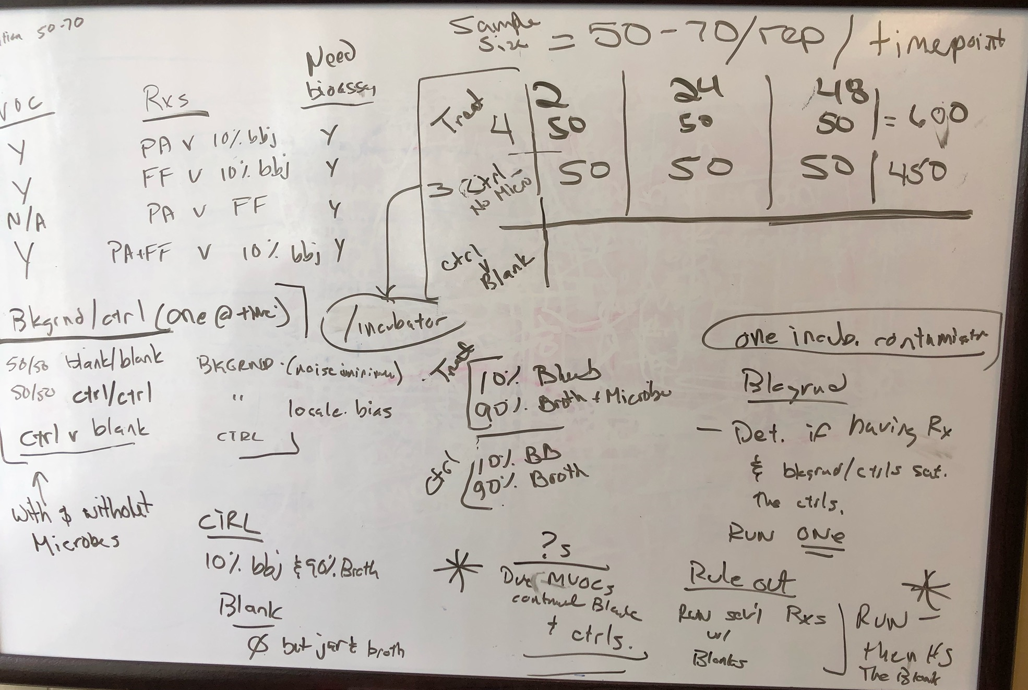

Slide 10
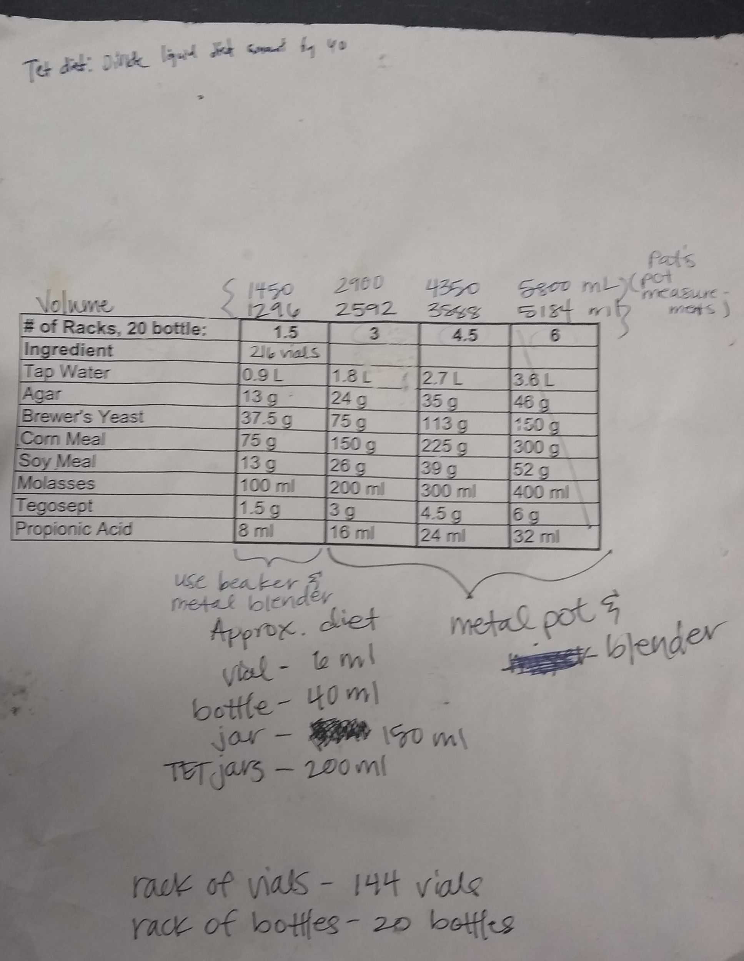

Slide 11
Purchase Items
Propionic Acid, BAKER™, J.T.Baker™ Quantity: 500mL, Packaging: Narrow Mouth Amber Glass Bottle
by J.T.Baker U33007 Catalog number 02-003-884
Soy Flour Quantity: 2260g
by MP Biomedicals™ 0296002405 Catalog number ICN96002405
Methyl 4-hydroxybenzoate, 99% Quantity: 250g
by Alfa Aesar™ A1428930 Catalog number AAA1428930
Brewers Yeast Quantity: 2260g
by MP Biomedicals™ 0290331205 Catalog number ICN90331205
PLUG, DROSOPHILA, FOAM
by Chemglass Life Sciences CGE4790005 Catalog number 50-189-7638
Fly bottle, square bottom polypropylene, 6 oz, 500/case
by Thomas Scientific 1158J85 Catalog number 50-146-1849

Slide 12
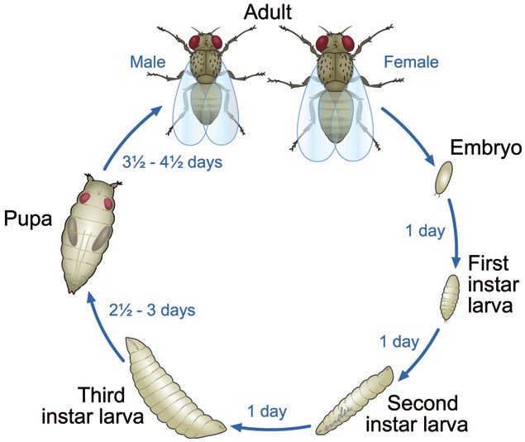
Life Cycle
Stage | Length (days)
Adult | 5
1st instar: | 1
2nd instar: | 1
3rd instar: | 2.5
Wandering: | 0.5
Pupa: | 5

Slide 13
Monthly Schedule
Monday | Tuesday | Wednesday | Thursday | Friday | Saturday | Sunday
 | Embryo (1) | Embryo (2) | Embryo (3)
 | Embryo (1) | Embryo (2) | Embryo (3) |  |  | Adult (1)
Adult (2) Starve (1) | Adult (3) Starve (2) 2H assay (1) | Starve (3) 24H assay (2) | 48H assay (3) |  |  | Adult (1)
Adult (2) Starve (1) | Adult (3) Starve (2) 2H assay (1) | Starve (3) 24H assay (2) | 48H assay (3)

